Slide 1
Join

Slide 2
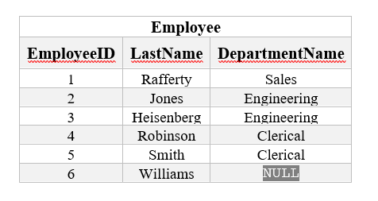
Problem?
Redundant Data!!!

Slide 3
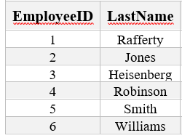
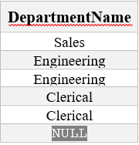
Solution
Employee Table
Department Table

Slide 4
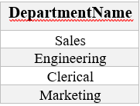
Solution
Employee Table
Department Table
Delete Redundant Data!

Slide 5
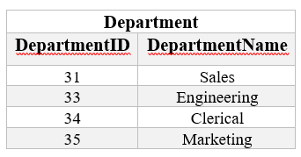
Solution Add primary key (ID)
Employee Table
Department Table

Slide 6
Solution
Employee Table
Department Table
How to make a relationship
between two tables?
Foreign Key

Slide 7
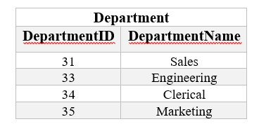
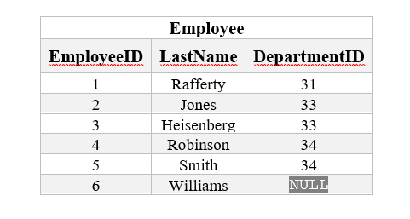

Solution
Employee Table
Department Table

Slide 8
Solution
Employee Table
Department Table

Slide 9
Structured Query Language (SQL)
SELECT <attribute list>
FROM <table list >
WHERE <condition>
Language for constructing a new table from argument table(s).
FROM indicates source tables
WHERE indicates which rows to retain
It acts as a filter
SELECT indicates which columns to extract from retained rows
Projection
The result is a table.

Slide 10
Example
SELECT Name
FROM Student
WHERE Id > 4999;
Id Name Address Status
1234 John 123 Main fresh
5522 Mary 77 Pine senior
9876 Bill 83 Oak junior
Student
Name
Mary
Bill
Result

Slide 11
Examples
SELECT Id, Name FROM Student;
SELECT Id, Name FROM Student
WHERE Status = 'senior';
SELECT * FROM Student
WHERE Status = 'senior‘;
SELECT COUNT(*) FROM Student
WHERE Status = 'senior';
result is a table with one column and one row

Slide 12
More Complex Example
Goal: table in which each row names a senior and gives a course taken and grade
Combines information in two tables:
Student: Id, Name, Address, Status
Transcript: StudId, CrsCode, Semester, Grade
SELECT Name, CrsCode, Grade
FROM Student, Transcript
WHERE StudId = Id AND Status = 'senior';

Slide 13
Join
T1
T2
SELECT a1, b1
FROM T1, T2
WHERE a2 = b2
a1 a2 a3
A 1 xxy
B 17 rst
b1 b2
3.2 17
4.8 17
a1 a2 a3 b1 b2
A 1 xxy 3.2 17
A 1 xxy 4.8 17
B 17 rst 3.2 17
B 17 rst 4.8 17
FROM T1, T2
yields:
WHERE a2 = b2
yields:
B 17 rst 3.2 17
B 17 rst 4.8 17
B 3.2
B 4.8
SELECT a1, b1
yields result:

Slide 14
Semantics of JOINs
SELECT x₁.a₁, x₁.a₂, …, x_{n}.a_{k}
FROM R₁ AS x₁, R₂ AS x₂, …, R_{n} AS x_{n}
WHERE Conditions(x₁,…, x_{n})
Answer = {}
for x₁ in R₁ do
for x₂ in R₂ do
…..
for x_{n} in R_{n} do
if Conditions(x₁,…, x_{n})
then Answer = Answer U {(x₁.a₁, x₁.a₂, …, x_{n}.a_{k})}
return Answer

Slide 15
An example of SQL semantics
A
3
3
SELECT R.A
FROM R, S
WHERE R.A = S.B
Output
A
1
3
R
A | B | C
1 | 2 | 3
1 | 3 | 4
1 | 3 | 5
3 | 2 | 3
3 | 3 | 4
3 | 3 | 5
Cross Product
B | C
2 | 3
3 | 4
3 | 5
Apply Selections / Conditions
Apply Projection
A | B | C
3 | 3 | 4
3 | 3 | 5
S

Slide 16
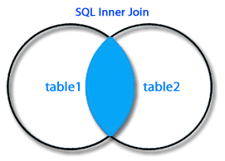
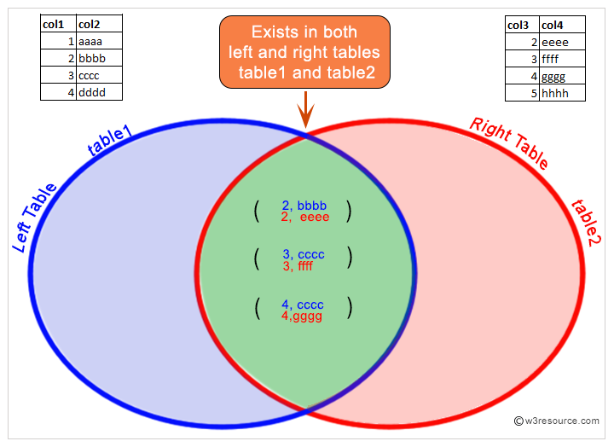
Join

Slide 17
Join Condition
The on condition allows a general predicate over the relations being joined.
This predicate is written like a where clause predicate except for the use of the keyword on.
Query example
select * from student join takes on student_ID = takes_ID
The on condition above specifies that a tuple from student matches a tuple from takes if their ID values are equal.
Equivalent to:
select * from student , takes where student_ID = takes_ID

Slide 18
End

